Slide 1
Kidney Exchange Program
Kjartan Þór Birgisson
Notes:
Hello! My name is Kjartan and I‘m going to briefly speak about Kidney Exchange Programs.

Slide 2
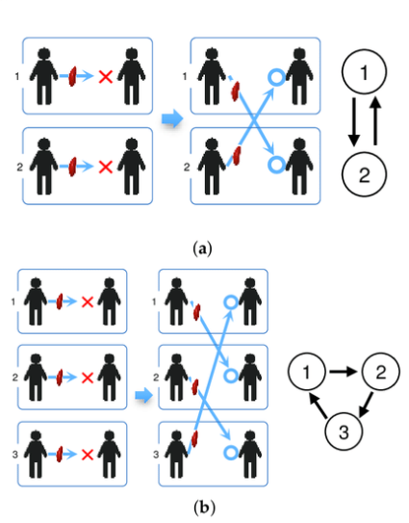
Kidney Exchange Program: Concept
A person in need of kidney transplant might have multiple persons willing to donate them a kidney.
No donor from that pool might be compatible.
People are much more likely to donate kidney to a friend or relative then a total stranger.
Solution: Create a pool of people in need of kidney transplant and along with the people willing to donate them a kidney.
Form kidney chains.
Notes:
-A known problem we have today is that a person that requires a kidney might have multiple friends and family members that are willing to donate them a kidney. However after testing these individuals, none of them is considered a compatible donor.
-That leaves the person in need of kidney with two options: Search for strangers that are willing to donate a kidney or wait for a deceased kidney donor that is a match.
-Since people are much more likely to donate a kidney to a friend or a relative, rather then to a total stranger. It could take a long time finding a stranger that is a match and willing to donate a kidney.
-Solution: Bring all people in need of kidney, along with all of their associates that are willing to donate a kidney into one pool and form kidney chains.
-That is: Two or more kidney recipients can exchange kidney donors.

Slide 3
Kidney Exchange Program: History
First implemented in New England 2004 – 2005.
Alvin E. Roth – 2012 Nobel Memorial Prize in Economic Sciences.
Has been implemented all over the world.
3-way exchange kidney chains considered optimal.
Longest kidney chain ever: 6-way exchange.
Notes:
Briefly on the history:
- The first kidney exchange program was implemented in New England in 2004-2005 by 2012 Nobel Price in Economic Sciences winner Alvin E. Roth.
Since then, these programs have been implemented in various places around the world.
According to the New England Kidney Exchange Program, 3 –way exchange kidney chains are considered optimal, but longer kidney chains happen, the longest being a 6-way exchange in San Fransisco in 2015.

Slide 4
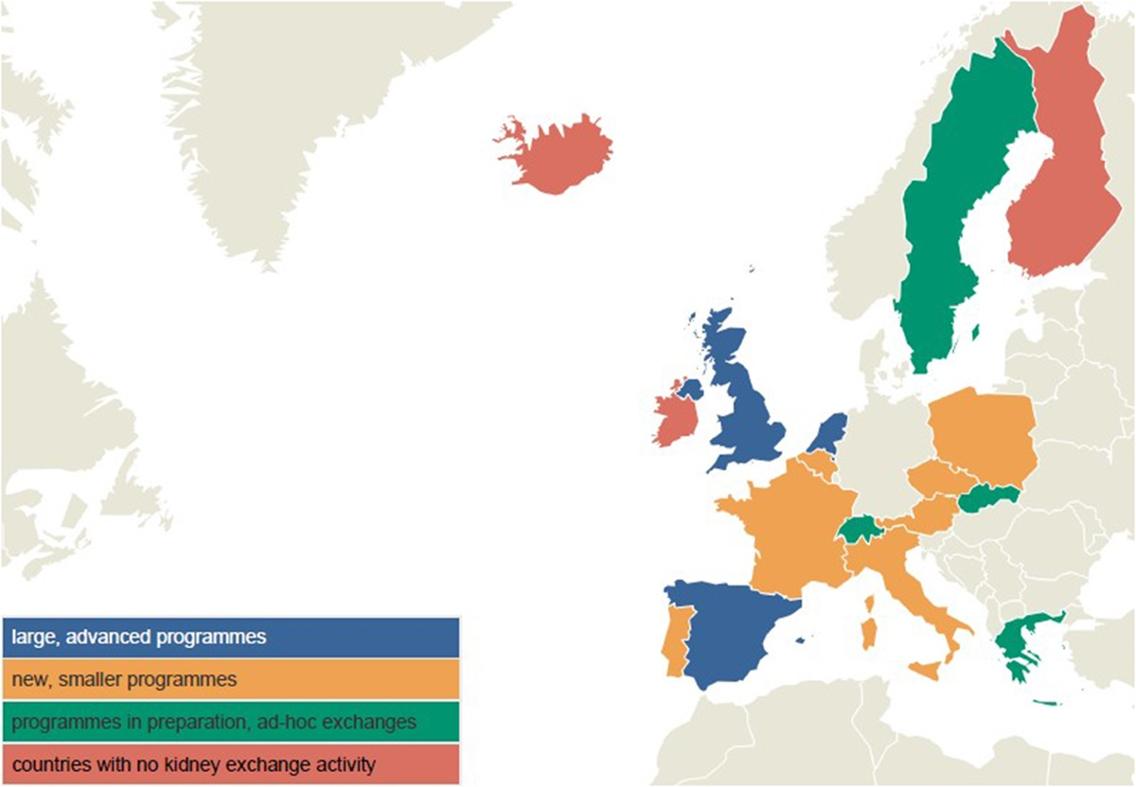
Kidney Exchange Programs: Europe
Notes:
Currently, Kidney Exchange Chains programs have been established in some European countries, in various stages, however I‘m unaware of any such attempt in Iceland.
Because of the size of the Icelandic population, there aren‘t many people that require a kidney each year. However we have a high distribution of Blood type O and maybe our isolation through out the last millenium has resulted fewer HLA Antigens variations. Both of these would result in higher donor / recipient compatability.

Slide 5
Kidney Exchange Program: Compatibility
Object: Minimize the likelihood of kidney being rejected by kidney transplant recipient.
Blood type: ˈAˈ, ˈBˈ, ˈABˈ, ˈOˈ
ˈOˈ can receive kidney from ˈOˈ
ˈAˈ can receive kidney from ˈAˈ or ˈOˈ
ˈBˈ can receive kidney from ˈBˈ or ˈOˈ
ˈABˈ can receive kidney from ˈABˈ, ˈAˈ, ˈBˈ or ˈOˈ
Rhesus (+/-), not important
Donor‘s Physical Condition: Age, BMI, eGFR, SBP, History of Smoking
Notes:
-When evaluating kidney donor and recipient compatibility the object is to minimize the likelihood of the kidney being rejected by the kidney transplant recipient.
-The factors taken into consideration and the impact of each one varies a little between healthcare systems. But they can be summarized into the following categories:
-Blood type compatibility, Donor physical condition and HLA antigen compatibility
-Blood type being the most important factor.
-Kidney transplants follow the same criteria when it comes to compatibility as blood transfusion except Rhesus (+/-) is not important.
-Donor‘s Physical Condition favors young, healthy individuals with great kidney functionality.

Slide 6
Kidney Exchange Program: Compatibility
HLA Antigen Matches
HLA-A
HLA-B
HLA-C
HLA-DR
Transplants performed even though several HLA mismatches exist
Notes:
HLA Antigen matches is the most complicated and debated factor. However transplants are performed, even if there are several mismatches found.
I was not able to obtain the exact criteria used by the Icelandic health care system in time, although I have been promised it. So I used a risk evaluation model from USA.

Slide 7
Kidney Exchange Program: Dataset
Complete:
Bloodtype Distribution - Vísindavefur
BMI Distribution – Landlæknir
History of Smoking Distribution – Landlæknir
Incomplete:
Systolic Blood Pressure Distribution – Hjartavernd
Heritage – Hagstofan
eGFR – Dutch study
Missing:
HLA distribution amongs the Icelandic population – deCode
Notes:
-My goal was to create a realistic random pool of Icelandic people with all the criteria that is used for kidney transplant compatibility.
-Unfortunatly, optaining the data was more difficult then I would have hoped for.
-The main flaw being lack of correlation between Systolic Blood Pressure, Estimated Glomerular Filtration Rate and Body Mass Index. So my distribution can create a person with a BMI of 45, but has a very healthy Systolic Blood Pressure and kidney functionality.
- I have been promised some of the remaining data shortly, the most important one the HLA Antigen distribution among the Icelandic Population.

Slide 8
Kidney Exchange Program: Method
Preprocessing
Genetic Algorithm
Sequence with Permutations
Objective Functions:
Longest possible kidney chain
Higher risk of kidney rejection
Logistical problems
Maximum kidney distribution
Higher risk of kidney rejection
Lowest risk kidney chain
Lowest risk of kidney rejection
Will favor a slightly lower risk 2-way exchange over a 3-way exchange
Constrained kidney chain size – Lowest risk kidney chain of that size selected
Accounts for logistics, f. ex. amount of kidney transplants possible at the same time
Notes:
I preprocess the data, by first calculating the risk of between each recipient and each donor in the pool.
Then I removed all kidney recipients that do not provide donors that were a match to others and all kidney recipients that were not a compatible match to the remaining donors.
I used a simple genetic algorithm, with chromosomes with amount of genes equal to kidney recipient that could provide a proper donor.
The chromosomes are sequencial and evolution was done with permutations.
I considered a few objective functions:
- Longest possible kidney chain
-Does not consider that smaller low risk kidney chains might exist
-Logistical problems – Surgical Capacity
- Maximum kidney distribution
- Does not consider risk
- Likely to be logistically easier.
- Lowest risk kidney chain
- Will always go for the lower risk kidney chain
- Will favor a slightly lower risk 2-way exchange over a 3-way exchange
- Super donors exist, young fit males in bloodtype O with great kidney function
- Constrained kidney chain size – Selecting the lowest risk kidney chain of that size.
- Accounts for logistics
- Favors kidney higher distribution
- Could be improved by favoring smaller kidney chains if a certain amount of risk is lowered.

Slide 9
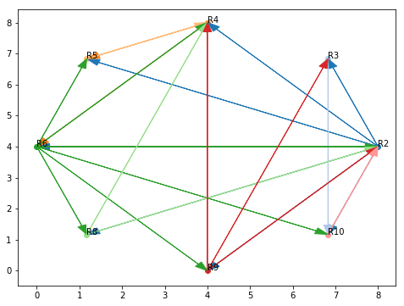
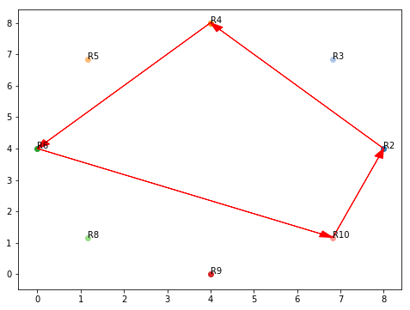
Kidney Exchange Program: Results
Possible Kidney Exchanges
Best 4-way Exchange Kidney Chain
Notes:
On the left you see all possible 1-way exchanges. There are 8 recipients, so 2 have been removed in preprocessing
The optimal 4-way exchange kidney chain is selected.

Slide 10
Kidney Exchange Program: Results
Donor #1 | Recipient #1 | Donor #2 | Recipient #2
Bloodtype: ˈOˈ History of Smoking: 0.0 Age: 34 eGFR: 108.85 BMI: 18.0 African Heritage: 0 SBP: 122.0 Gender: 0 | Bloodtype: ˈBˈ History of Smoking: 1.0 Age: 55 eGFR: 60.42 BMI: 19.0 African Heritage: 0 SBP: 120.0 Gender: 1 | Bloodtype: ˈOˈ History of Smoking: 0.0 Age: 51 eGFR: 62.18 BMI: 21.0 African Heritage: 0 SBP: 120.0 Gender: 1 | Bloodtype: ˈOˈ History of Smoking: 0.0 Age: 29 eGFR: 97.76 BMI: 30.0 African Heritage: 0 SBP: 108.0 Gender: 1
Unrelated: 1.0 HLA-B Mismatches: 2.0 HLA-DR Mismatches: 1.0 |  | Unrelated: 1.0 HLA-B Mismatches: 0.0 HLA-DR Mismatches: 1.0
Donor #3 | Recipient #3 | Donor #4 | Recipient #4
Bloodtype: ˈOˈ History of Smoking: 0.0 Age: 19 eGFR: 104.52 BMI: 24.0 African Heritage: 0 SBP: 122.0 Gender: 0 | Bloodtype: ˈAˈ History of Smoking: 1.0 Age: 44 eGFR: 88.55 BMI: 18.0 African Heritage: 0 SBP: 122.0 Gender: 0 | Bloodtype: ˈOˈ History of Smoking: 0.0 Age: 36 eGFR: 86.52 BMI: 20.0 African Heritage: 0 SBP: 122.0 Gender: 0 | Bloodtype: ˈAˈ History of Smoking: 0.0 Age: 27 eGFR: 81.81 BMI: 27.0 African Heritage: 0 SBP: 108.0 Gender: 1
Unrelated: 1.0 HLA-B Mismatches: 1.0 HLA-DR Mismatches: 0.0 |  | Unrelated: 1.0 HLA-B Mismatches: 1.0 HLA-DR Mismatches: 1.0
Notes:
Most common donors selected are young, fit and in blood type O

Slide 11
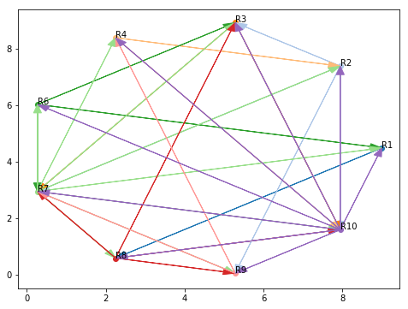
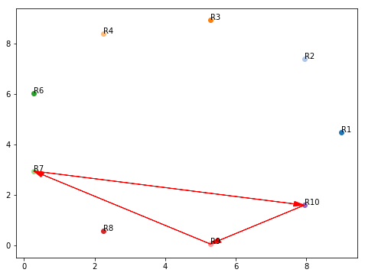
Kidney Exchange Program: Results
Possible Kidney Exchanges
Best 3-way Exchange Kidney Chain
Notes:
On the left you see all possible 1-way exchanges. There are 9 recipients, so 1 has been removed by preprocessing
The optimal 3-way exchange kidney chain is selected.

Slide 12
Kidney Exchange Program: Results
Donor #1 | Recipient #1 | Donor #2 | Recipient #2 | Donor #3 | Recipient #3
Bloodtype: ˈOˈ History of Smoking: 0.0 Age: 21 eGFR: 85.84 BMI: 21.0 African Heritage: 0 SBP: 108.0 Gender: 1 | Bloodtype: ˈAˈ History of Smoking: 0.0 Age: 28 eGFR: 84.94 BMI: 35.0 African Heritage: 0 SBP: 108.0 Gender: 1 | Bloodtype: ˈOˈ History of Smoking: 0.0 Age: 18 eGFR: 107.16 BMI: 23.0 African Heritage: 0 SBP: 108.0 Gender: 1 | Bloodtype: ˈOˈ History of Smoking: 0.0 Age: 39 eGFR: 82.03 BMI: 24.0 African Heritage: 0 SBP: 108.0 Gender: 1 | Bloodtype: ˈOˈ History of Smoking: 0.0 Age: 18 eGFR: 114.72 BMI: 27.0 African Heritage: 0 SBP: 122.0 Gender: 0 | Bloodtype: ˈABˈ History of Smoking: 1.0 Age: 38 eGFR: 76.77 BMI: 22.0 African Heritage: 0 SBP: 108.0 Gender: 1
Unrelated: 1.0 HLA-B Mismatches: 0.0 HLA-DR Mismatches: 1.0 |  | Unrelated: 1.0 HLA-B Mismatches: 1.0 HLA-DR Mismatches: 2.0 |  | Unrelated: 1.0 HLA-B Mismatches: 1.0 HLA-DR Mismatches: 1.0

Slide 13
Kidney Exchange Program: Further work
Obtain the minimum criteria used by the Icelandic Health Care System to evaluate Donor/Recipient compatibility
Obtain the incomplete and missing datasets in order to properly represent the Icelandic population
Estimate if a Kidney Exchange Program could be economically beneficial for the Icelandic Health Care System
Notes:
To take this further the following task need to be completed:
- Minimum Criteria – Icelandic Health Care System
- Improve Dataset, More Realistic Representation of the Icelandic Population
- Stóra Reykjavíkurrannsóknin
- HLA Distribution
- Estimate the Economical Benifit of Implementing a Kidney Exchange Program in Iceland
- Health Care Cost for a person waiting for a kidney
- Society Cost
- Cost of implementing and running a Kidney Exchange Program – Privitize?

